Slide 1
MICROPROCESSOR AND ASSEMBLY LANGUAGE LECTURES Volume-3
Instructions
Addressing Modes

Slide 2
Instruction Format, Machine Codes and Addressing Modes

Slide 3
Computer Programming Languages
Machine Language
Machine language is the lowest-level programming language (except for computers that utilize programmable microcode). Machine languages are the only languages understood by computers.
Assembly Language
While easily understood by computers, machine languages are almost impossible for humans to use because they consist entirely of numbers.
Programmers, therefore, use either a high-level programming language or an assembly language.
An assembly language contains the same instructions as a machine language, but the instructions and variables have names instead of being just numbers.
An ”assembler” translates assembly language into machine code.

Slide 4
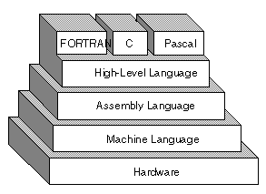
Computer Programming languages

Slide 5
Computer Program and Instruction
The sequence of commands used to tell a microcomputer what to do is called a program,
Each command in a program is called an instruction
8086 understands and performs operations for 117 basic instructions
The native language of the IBM PC is the machine language of the 8086
A program written in machine language is referred to as machine code
In 8086 assembly language, each of the operations is described by alphanumeric symbols instead of 0-1s.
Label: ADD AX, BX ; Comment
Label Opcode Operands Comment

Slide 6
Instruction
The language to command a computer architecture is comprised of instructions and the vocabulary of that language is called the instruction set.
An instruction is a statement that is executed at runtime. An x86 instruction statement can consist of four parts:
Label (optional)- A label typically consists of an identifier (or symbol) followed by a colon
Instruction (Opcode) (required)
Operands (instruction specific)
Comment (optional)

Slide 7
Instruction Structure
LABEL: OPCODE, OPERAND/S ; COMMENT
1 2 3 4
Address identifier Does not generate any machine code
Example:
START: MOV AX, BX ; copy BX into AX
There is a one-to-one relationship between assembly and machine language instructions.
A compiled machine code implementation of a program written in a high-level language results in inefficient code
– More machine language instructions than an assembled version of an equivalent handwritten assembly language program

Slide 8
Advantages and disadvantages of Assembly Language
Advantages of using an Assembler:
Very fast in translating assembly language to machine code as 1 to 1 relationship
Assembly code is often very efficient (and therefore fast) because it is a low level language
Assembly code is fairly easy to understand due to the use of English-like mnemonics
Disadvantages of using Assembler:
Assembly language is written for a certain instruction set and/or processor
Assembly tends to be optimized for the hardware it's designed for, meaning it is often incompatible with different hardware
Lots of assembly code is needed to do relatively simple tasks, and complex programs require lots of programming time

Slide 9
Two key benefits of assembly
language programming
It takes up less memory
It executes much faster

Slide 10
Applications of Assembly Language
One of the most beneficial uses of assembly language programming is:
Real-time applications.
Real time means the task required by the application must be completed before any other input to the program that will alter its operation may occur
For example the device service routine which controls the operation of the floppy disk drive is a good example that is usually written in assembly language

Slide 11
Applications of Assembly Language
Continued ...
Assembly language not only good for controlling hardware devices but also performing pure software operations
– Searching through a large table of data for a special string of characters
– Code translation from ASCII to EBCDIC
– Table sort routines
– Mathematical routines
Assembly language: perform real-time operations
High-level languages: used to write those parts that are not time critical
Notes:
EBCDIC = Extended Binary Coded Decimal Interchange Code
ASCII = American Standard Code for Information Interchange

Slide 12
Instruction formats of 8086
The instruction format of 8086 has one or more number of fields associated with it.
The first filled is called operation code field or opcode field, which indicates the type of operation.
The instruction format also contains other fields known as operand fields.
There are six general formats of instructions in 8086 instruction set.
The length of an instruction may vary from one byte to six bytes.

Slide 13
One byte Instruction !
This format is only one byte long and may have the implied data or register operands.
The least significant 3 bits of the opcode are used for specifying the register operand, if any. Otherwise, all the eight bits form an opcode and the operands are implied.
Example: 1 1 1 1 1 0 0 0₂ = F8_{H} (CLC : clear carry flag)
This is an operation without any operand, which clear the carry flag bit.

Slide 14
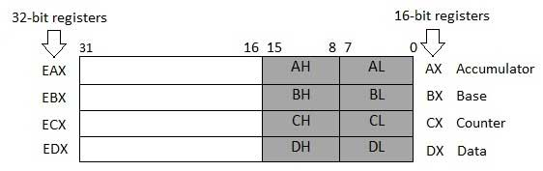
32-bit Data Registers
There are ten 32-bit and six 16-bit processor registers in IA-32 (386 – Pentium 4) architecture
Four 32-bit data registers are used for arithmetic, logical, and other operations. These 32-bit registers can be used in three ways −
As complete 32-bit data registers: EAX, EBX, ECX, EDX.
Lower halves of the 32-bit registers can be used as four 16-bit data registers: AX, BX, CX and DX.
Lower and higher halves of the above-mentioned four 16-bit registers can be used as eight 8-bit data registers: AH, AL, BH, BL, CH, CL, DH, and DL.

Slide 15
Registers and Typical Uses
AX is the primary accumulator; it is used in input/output and most arithmetic instructions. For example, in multiplication operation, one operand is stored in EAX or AX or AL register according to the size of the operand.
BX is known as the base register, as it could be used in indexed addressing.
CX is known as the count register, as the ECX, CX registers store the loop count in iterative operations.
DX is known as the data register. It is also used in input/output operations. It is also used with AX register along with DX for multiply and divide operations involving large values.

Slide 16

Typical 2-Byte Instruction Structure
15 ------ 10 | 9 | 8 | 7 ---- 6 | 5 ---- 3 | 2 ---- 0
BYTE 1 | BYTE 2

Slide 17
Converting Assembly Language Instructions to Machine Code
An instruction can be coded with 1 to 6 bytes
Byte 1 contains three Fields
– Opcode field (6 bits) specifies the operation (add, subtract, move)
– Register Direction Bit (D bit) Tells the register operand in REG field in byte 2 is source or destination operand
1: destination 0: source
-Data Size Bit (W bit) Specifies whether the operation will be performed on 8-bit or 16-bit data
0: 8 bits 1: 16 bits
15 ------- 10 | 9 | 8 | 7 ---- 6 | 5 ---- 3 | 2 ---- 0

Slide 18
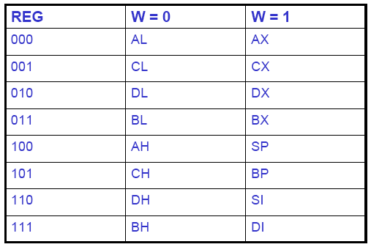
Byte-2 has three fields
Mode field (MOD) Addressing mode
Register field (REG) used to identify the register for the first operand
Register/memory field (R/M)
15 ------- 10 | 9 | 8 | 7 ---- 6 | 5 ---- 3 | 2 ---- 0

Slide 19
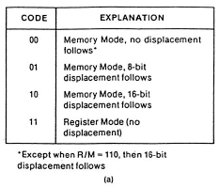
2-bit MOD field
15 ------- 10 | 9 | 8 | 7 ---- 6 | 5 ---- 3 | 2 ---- 0

Slide 20
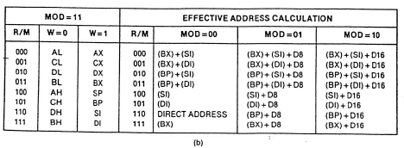
R/M field together specify the second operand
15 ------- 10 | 9 | 8 | 7 ---- 6 | 5 ---- 3 | 2 ---- 0

Slide 21
Example: MOV BL,AL
Example of MOV Instruction
1 0 0 0 1 0 | 0 | 0 | 1 1 | 0 0 0 | 0 1 1
Opcode for MOV = 100010
D = 0 (AL source operand)
W bit = 0 (8-bits)
Therefore byte 1 is 10001000₂= 88₁₆
• MOD = 11 (register mode)
• REG = 000 (code for AL)
• R/M = 011 (destination is BL)
Therefore Byte 2 is 11000011₂=C3₁₆

Slide 22
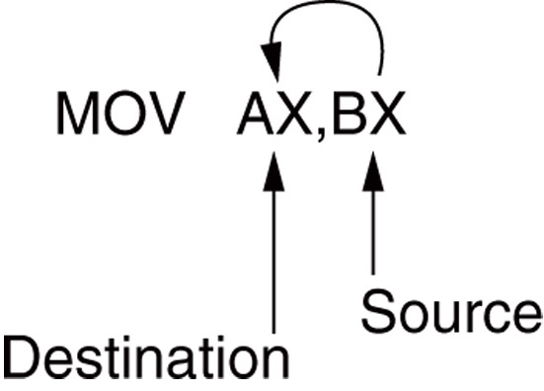
Instruction Source and Destination
MOV instruction is a common and flexible instruction.
Source is to the right and destination the left, next to the opcode MOV.
an opcode, or operation code, tells the microprocessor which operation to perform

Slide 23
Data Addressing Modes Categories
9 Categories of Addressing Modes -
Register Addressing
Immediate
Direct
Register Indirect
Base-plus-Index
Register relative
Base relative-plus-index
Scaled-Index
RIP (Relative Instruction-Pointer)
Note: The 8086 processor has 24 types of addressing modes grouped into 9 categories (Ref. Raj Kumar P.17)
Note: Read Pages 78 to 81

Slide 24
Data Addressing Modes using MOV
2 Examples of MOV Instructions-
MOV AX, BX ; Register type Mode
MOV CH, 3Ah ; Immediate type mode
Figure 3–2 (Next Slide) shows all possible variations of the data-addressing modes using MOV.
These data-addressing modes are found with all versions of the Intel microprocessor.
except for the scaled-index-addressing mode, found only in 80386 through Core2 processors.

Slide 25
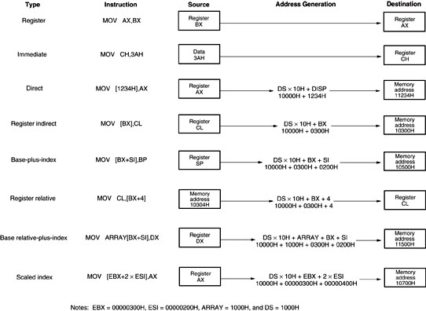
Figure 3–2 8086–Core2 data-addressing modes using MOV

Slide 26
Register Addressing
The most common form of data addressing.
In this addressing mode, a register contains the operand. Depending upon the instruction, the register may be the first operand, the second operand or both.
Examples:
MOV DX, TAX_RATE ; Register in first operand
MOV COUNT, CX ; Register in second operand
MOV EAX, EBX ; Both the operands are in registers
As processing data between registers does not involve memory, it provides fastest processing of data.

Slide 27
Register Addressing using Register Names and Bits
Register Names:
(once register names learned, easiest to apply)
8-bit register names used with register addressing: AH, AL, BH, BL, CH, CL, DH, and DL.
16-bit register names: AX, BX, CX, DX, SP, BP, SI, and DI.

Slide 28
Register Names and Bits
Continued ....
Extended 32-bit (In 80386 & above) register names: EAX, EBX, ECX, EDX, ESP, EBP, EDI, and ESI.
64-bit (Pentium 4) mode register names: RAX, RBX, RCX, RDX, RSP, RBP, RDI, RSI, and R8 through R15.
Important for instructions: to use registers that are the same size.
never mix an 8-bit with a 16-bit register, an 8- or a 16-bit register with a 32-bit register
this is not allowed by the microprocessor and results in an error when assembled

Slide 29
Continued ....
Figure 3–3 shows the operation of the MOV BX, CX instruction.
The source register’s contents do not change.
the destination register’s contents do change
The contents of the destination register or destination memory location change for all instructions except the CMP and TEST instructions.
The MOV BX, CX instruction does not affect the leftmost 16 bits of register EBX.

Slide 30
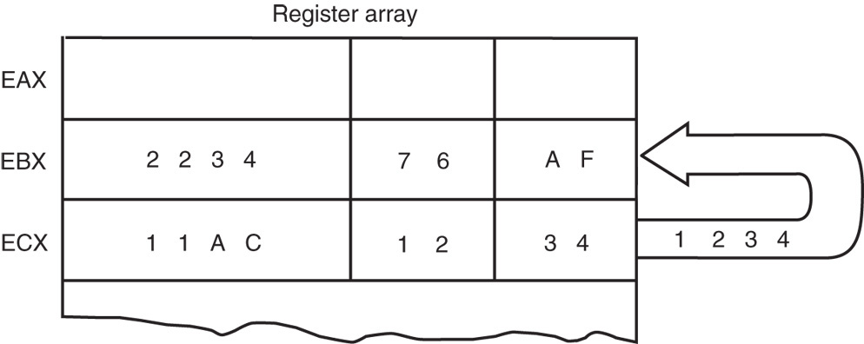
Figure 3-3 The effect of executing the MOV BX, CX instruction at the point just before the BX register changes. Note that only the rightmost 16 bits of register EBX change.
MOV BX, CX instruction on 32-bit Registers

Slide 31
Immediate Addressing
An immediate operand has a constant value or an expression.
In immediate addressing the instruction always take up two bytes in program memory; one for the opcode, and the other byte is a constant to be taken "immediately".
When two operands are used in immediate addressing, the first operand may be a register or memory location, and the second operand is an immediate constant. The first operand defines the length of the data.
Examples:
MOV AX, 45H ; Immediate constant 45H is transferred to AX
LDA #64 ; The Byte 64₁₀, or 40_{H} is to be loaded into the accumulator

Slide 32
Immediate Addressing Continued ...
Term immediate implies that data immediately follow the hexadecimal opcode in the memory.
immediate data are constant data
data transferred from a register or memory location are variable data
Immediate addressing operates upon a byte or word of data.
Figure 3–4 shows the operation of a MOV EAX, 3456_{H} instruction.

Slide 33
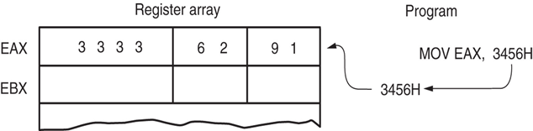
Figure 3–4 The operation of the MOV EAX,3456H instruction. This instruction copies the immediate data (3456H) into EAX.
MOV Immediate instruction: source data overwrites
the destination data.
As with the MOV instruction illustrated in Figure 3–3, the source data overwrites the destination data.

Slide 34
MOV Immediate: Instruction
Symbolic
In symbolic assembly language, the symbol # precedes immediate data in some assemblers.
MOV AX,#3456H instruction is an example
Most assemblers do not use the # symbol, but represent immediate data as in the MOV AX,3456H instruction.
an older assembler used with some Hewlett-Packard logic development does, as may others
in this text, the # is not used for immediate data

Slide 35
MOV Immediate: Instruction Symbolic
Continued ..
The symbolic assembler portrays immediate data in many ways.
The letter H appends hexadecimal data.
If hexadecimal data begin with a letter, the assembler requires the data start with a 0.
to represent a hexadecimal F2, 0F2H is used in assembly language
Decimal data are represented as is and require no special codes or adjustments.
an example is the 100 decimal in the MOV AL,100 instruction

Slide 36
Examples of Immediate Addressing
An ASCII-coded character or characters may be depicted in the immediate form if the ASCII data are enclosed in apostrophes.
Example: MOV AL,’A’; Copies SSCII A into AL
be careful to use the apostrophe (‘) for ASCII data and not the single quotation mark (‘)
Binary data are represented if the binary number is followed by the letter B.
Example (8-bit):
MOV CL,1100110B; Copies 1100110_{B} into CL,
Example (32-bit):
MOV EBX, 12340000H; Copies 12340000_{H} into EBX
Note: See Table 3-2

Slide 37
Assembly Program Statement Parts
Each statement in an assembly language program consists of four parts or fields.
The leftmost field is called the label.
used to store a symbolic name for the memory location it represents
All labels must begin with a letter or one of the following special characters: @, $, -, or ?.
a label may any length from 1 to 35 characters
The label appears in a program to identify the name of a memory location for storing data and for other purposes.
Example: START: MOV AL,BL ; Copy BL into AL
See Example 3-3 (Important)

Slide 38
Assembly Statement Parts
Continued ...
The next field to the right is the opcode field.
designed to hold the instruction, or opcode
the MOV part of the move data instruction is an example of an opcode
Right of the opcode field is the operand field.
contains information used by the opcode
the MOV AL,BL instruction has the opcode MOV and operands AL and BL
The comment field, the final field, contains a comment about the instruction(s).
comments always begin with a semicolon (;)

Slide 39
DIRECT ADDRESSING MODE
In direct addressing mode, the data to be operated is available inside a memory location and that memory location is directly specified as an operand. The operand is directly available in the instruction itself.
Examples:
MOV AL,[1234H] Copies the Byte content of 1234H into AL
MOV AL,NUMBER (8-bit) (Copies the byte contents of data segment memory location NUMBER into AL)
MOV NEWS,AL (8 bits) Copies AL into byte memory location NEWS
MOV THERE,AX (16 bits) Copies AX into word memory location THERE
MOV HOME,EAX (32 bit) Copies EAX into doubleword memory location HOME LDA 2050 Load the contents of memory location 2050 into accumulator A)
See TABLE 3-3

Slide 40
Direct Data Addressing Continued ...
Applied to many instructions in a typical program.
Two basic forms of direct data addressing:
direct addressing, which applies to a MOV between a memory location and AL, AX, or EAX
displacement (Offset) addressing, which applies to almost any instruction in the instruction set
Address is formed by adding the displacement to the default data segment address or an alternate segment address.

Slide 41
Direct Addressing Continued ...
Direct addressing with a MOV instruction transfers data between a memory location, located within the data segment, and the AL (8-bit), AX (16-bit), or EAX (32-bit) register.
usually a 3-byte long instruction
MOV AL,DATA loads AL from the data segment memory location DATA (1234H).
DATA is a symbolic memory location, while 1234H is the actual hexadecimal location

Slide 42
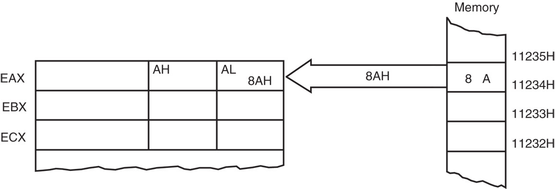
Figure 3–5 The operation of the MOV AL,[1234H] instruction when DS=1000H .
OPERATION OF DIRECT ADDRESSING
This instruction transfers a copy contents of memory location 11234H into AL.
the effective address is formed by adding 1234H (the offset address) and 10000H (the data segment address of 1000H times 10H) in a system operating in the real mode
Notes:
Real mode, also called real address mode, is an operating mode of all x86-compatible CPUs. Real mode is characterized by a 20-bit segmented memory address space (giving exactly 1 MiB of addressable memory) and unlimited direct software access to all addressable memory, I/O addresses and peripheral hardware.
In protected mode the OS can use features like paging and virtual memory. Also real mode code is never in 32 bits whereas protected mode code can be 16 bits or 32 bits. Every x86 cpu starts in real mode and the OS must switch to protected mode.

Slide 43
How to calculate Physical Address?
Register which holds the Effective Address (EA)/Offset
will be specified in the instruction.
Registers used to hold EA/OFFSET are any of the following registers: BX, BP, DI and SI.
Content of the DS register is used for base address calculation.
Physical Address = DS * 10H + OFFSET
NOTE: Offset is the displacement of the memory location from the starting location of the segment.

Slide 44
Displacement Addressing
Kind of direct addressing
Almost identical to direct addressing, except the instruction is 4 bytes wide instead of 3.
In 80386 through Pentium 4, this instruction can be up to 7 bytes wide if a 32-bit register and a 32-bit displacement are specified.
This type of direct data addressing is much more flexible because most instructions use it.

Slide 45
Register Indirect Addressing
Allows data to be addressed at any memory location through an offset address held in any of the following registers: BP, BX, DI, and SI.
In addition, 80386 and above allow register indirect addressing with any extended register except ESP.
In the 64-bit mode, the segment registers serve no purpose in addressing a location in the flat model.

Slide 46
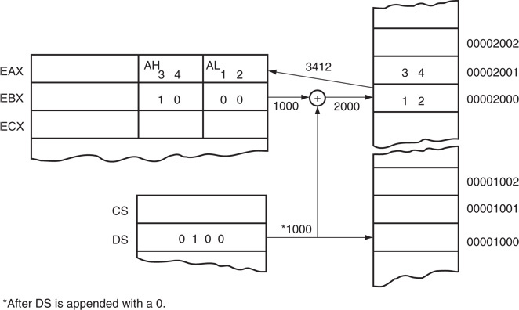
Figure 3–6 The operation of the MOV AX,[BX] instruction when BX = 1000H and DS = 0100H. Note that this instruction is shown after the contents of memory are transferred to AX.
Register Indirect Addressing Operation

Slide 47
The data segment is used by default with register indirect addressing or any other mode that uses BX, DI, or SI to address memory.
If the BP register addresses memory, the stack segment is used by default.
these settings are considered the default for these four index and base registers
For the 80386 and above, EBP addresses memory in the stack segment by default.
EAX, EBX, ECX, EDX, EDI, and ESI address memory in the data segment by fault.

Slide 48
When using a 32-bit register to address memory in the real mode, contents of the register must never exceed 0000FFFFH.
In the protected mode, any value can be used in a 32-bit register that is used to indirectly address memory.
as long as it does not access a location outside the segment, dictated by the access rights byte
In the 64-bit mode, segment registers are not used in address calculation; the register contains the actual linear memory address.

Slide 49
In some cases, indirect addressing requires specifying the size of the data by the special assembler directive BYTE PTR, WORD PTR, DWORD PTR, or QWORD PTR.
these directives indicate the size of the memory data addressed by the memory pointer (PTR)
The directives are with instructions that address a memory location through a pointer or index register with immediate data.
With SIMD instructions, the octal OWORD PTR, represents a 128-bit-wide number.

Slide 50
Indirect addressing often allows a program to refer to tabular data located in memory.
Figure 3–7 shows the table and the BX register used to sequentially address each location in the table.
To accomplish this task, load the starting location of the table into the BX register with a MOV immediate instruction.
After initializing the starting address of the table, use register indirect addressing to store the 50 samples sequentially.

Slide 51
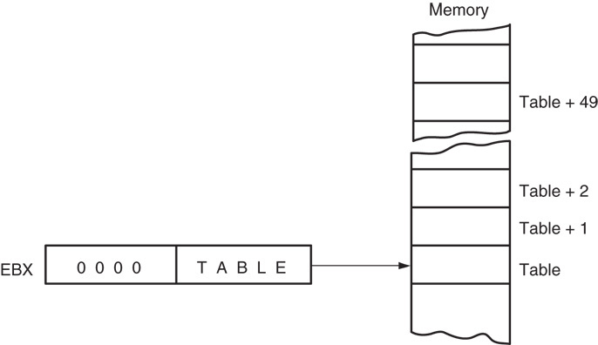
Figure 3–7 An array (TABLE) containing 50 bytes that are indirectly addressed through register BX.
REGISTER INDIRECT ADDRESSING
BLOCK DIAGRAM

Slide 52
Base-Plus-Index Addressing
Similar to indirect addressing because it indirectly addresses memory data.
The base register often holds the beginning location of a memory array.
the index register holds the relative position of an element in the array
whenever BP addresses memory data, both the stack segment register and BP generate the effective address

Slide 53
Locating Data with Base-Plus-Index Addressing
Figure 3–8 shows how data are addressed by the MOV DX,[BX + DI] instruction when the microprocessor operates in the real mode.
The Intel assembler requires this addressing mode appear as [BX][DI] instead of [BX + DI].
The MOV DX,[BX + DI] instruction is MOV DX,[BX][DI] for a program written for the Intel ASM assembler.

Slide 54
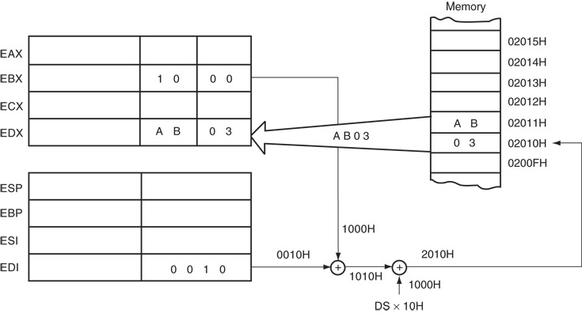
Figure 3–8 An example showing how the base-plus-index addressing mode functions for the MOV DX,[BX + DI] instruction. Notice that memory address 02010H is accessed because DS=0100H, BX=100H and DI=0010H.
An example showing the base-plus-index addressing mode functions for the
MOV DX,[BX + DI] instruction

Slide 55
Locating Array Data Using Base-Plus-Index Addressing
A major use is to address elements in a memory array.
To accomplish this, load the BX register (base) with the beginning address of the array and the DI register (index) with the element number to be accessed.
Figure 3–9 shows the use of BX and DI to access an element in an array of data.

Slide 56
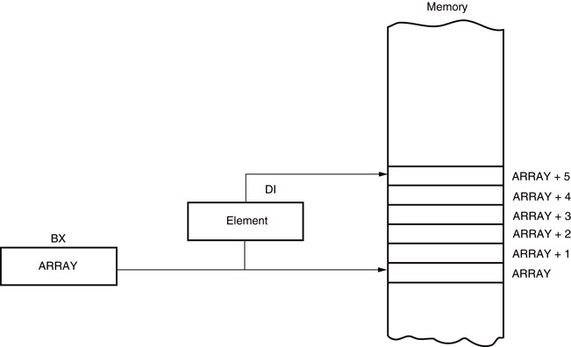
Figure 3–9 An example of the base-plus-index addressing mode. Here an element (DI) of an ARRAY (BX) is addressed.
An example of the base-plus-index addressing mode

Slide 57
Register Relative Addressing
Similar to base-plus-index addressing and displacement addressing.
data in a segment of memory are addressed by adding the displacement to the contents of a base or an index register (BP, BX, DI, or SI)
Figure 3–10 shows the operation of the MOV AX,[BX+1000H] instruction.
A real mode segment is 64K bytes long.

Slide 58
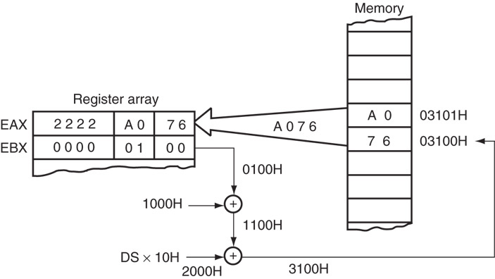
Figure 3–10 The operation of the MOV AX, [BX=1000H] instruction, when BX=1000H and DS=0200H .
The operation of the MOV AX, [BX=1000H] instruction

Slide 59
Addressing Array Data with Register Relative
It is possible to address array data with register relative addressing.
such as with base-plus-index addressing
In Figure 3–11, register relative addressing is illustrated with the same example as for base-plus-index addressing.
this shows how the displacement ARRAY adds to index register DI to generate a reference to an array element

Slide 60
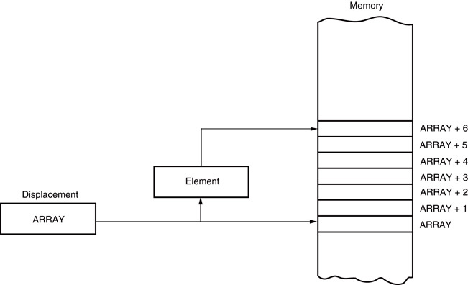
Figure 3–11 Register relative addressing used to address an element of ARRAY. The displacement addresses the start of ARRAY, and DI accesses an element.
Register relative addressing used to address an element of ARRAY

Slide 61
Base Relative-Plus-Index Addressing
Similar to base-plus-index addressing.
adds a displacement
uses a base register and an index register to form the memory address
This type of addressing mode often addresses a two-dimensional array of memory data.

Slide 62
Addressing Data with Base Relative-Plus-Index
Least-used addressing mode.
Figure 3–12 shows how data are referenced if the instruction executed by the microprocessor is MOV AX,[BX + SI + 100H].
displacement of 100H adds to BX and SI to form the offset address within the data segment
This addressing mode is too complex for frequent use in programming.

Slide 63
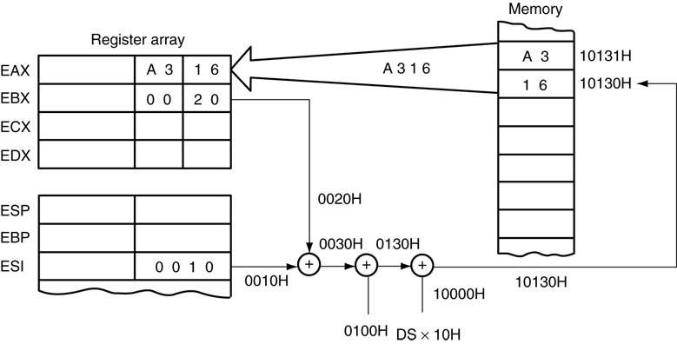
Figure 3–12 An example of base relative-plus-index addressing using a MOV AX,[BX+SI+1000H] instruction. Note: DS=1000H
An example of base relative-plus-index addressing

Slide 64
Addressing Arrays with Base Relative-Plus-Index
Suppose a file of many records exists in memory, each record with many elements.
displacement addresses the file, base register addresses a record, the index register addresses an element of a record
Figure 3–13 illustrates this very complex form of addressing.

Slide 65
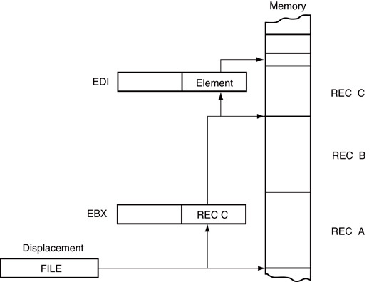
Figure 3–13 Base relative-plus-index addressing used to access a FILE that contains multiple records (REC).
Base relative-plus-index addressing

Slide 66
Scaled-Index Addressing
Unique to 80386 - Core2 microprocessors.
uses two 32-bit registers (a base register and an index register) to access the memory
The second register (index) is multiplied by a scaling factor.
the scaling factor can be 1x, 2x, 4x, 8x
A scaling factor of is implied and need not be included in the assembly language instruction (MOV AL,[EBX + ECX]).

Slide 67
RIP Relative Addressing
Uses the 64-bit instruction pointer register in the 64-bit mode to address a linear location in the flat memory model.
Inline assembler program available to Visual does not contain any way of using this mode or any other 64-bit addressing mode.
The Microsoft Visual does not at present support developing 64-bit assembly code.

Slide 68
MICROPROCESSOR VOLUME-3
THE END

